Slide 1





Your Local Grocery stores
& delivery Network

Slide 2


In a world of coronavirus threats,
we give you the safest way to get
your food while staying at home

Slide 3


Slide 4





Team Members
Engin Polat
Full Stack Engineer Growcherry App
Yael Liver
Team Lead & Product Manager
Adva Dav Bar
UX, UI Designer
& Branding
Yizhar Goldstein
Backend Developer Growcherry Web & App
Yossi Shmoel
Backend Developer Growcherry Web

Slide 5
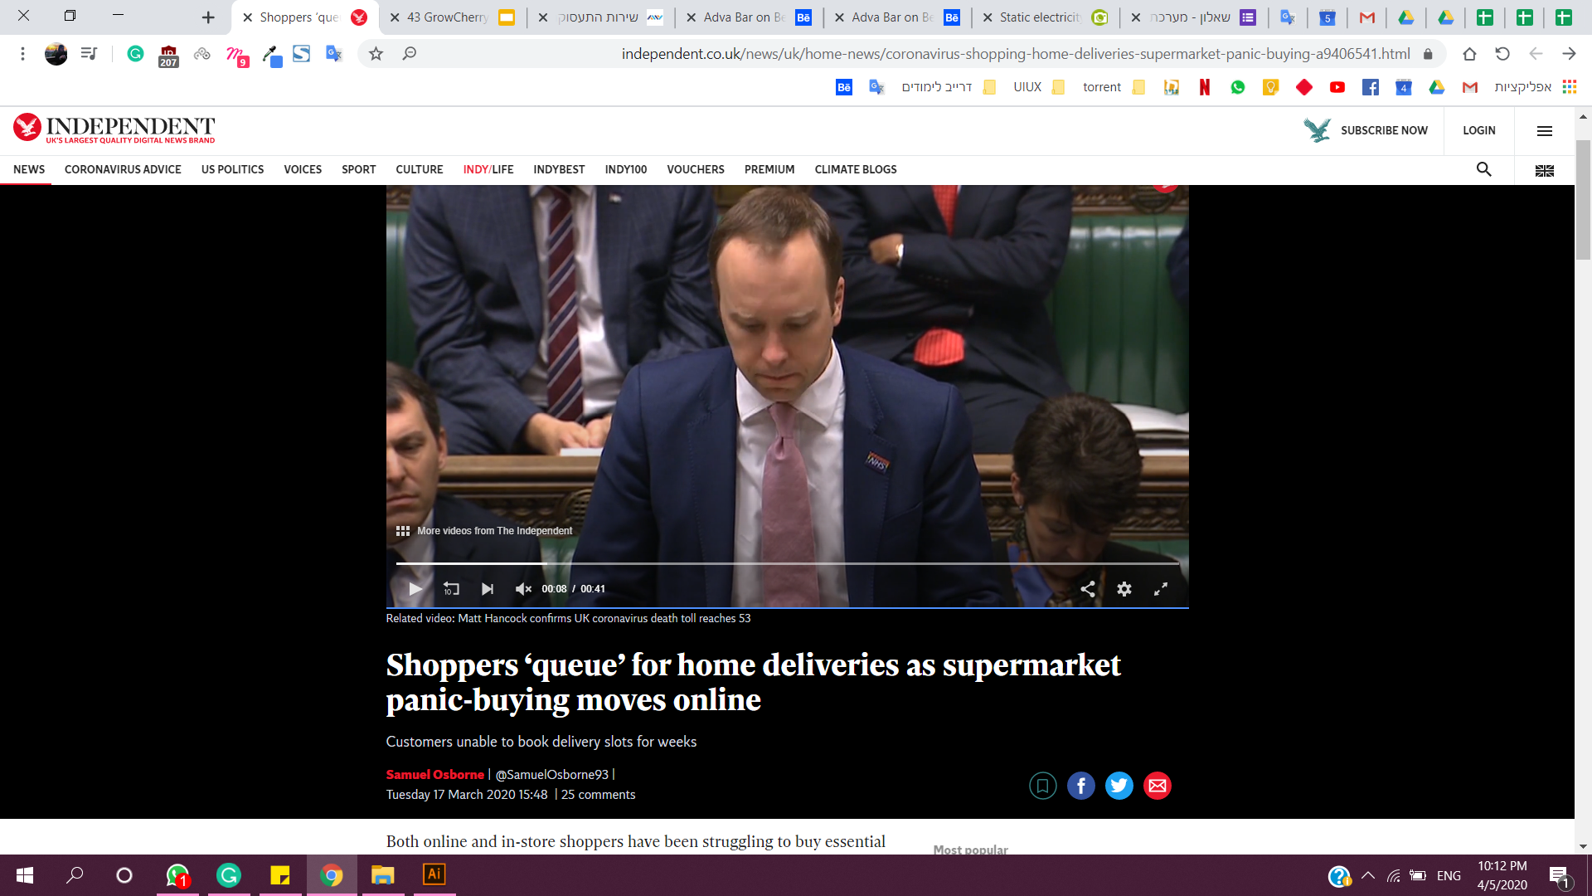
The problem &
Market needs
The coronavirus pandemic created new restrictions that grocery stores and Supermarkets have to work under pressure : In Israel, a business must not hold more than 10 customers within the same store.
Due to these new restrictions a large number of customers went through to place food orders through digital platforms, but find it hard to use, especially for elderly.
Many Grocery stores are unable to accept multiple orders at the same time, and hold a small number of delivery workers. Which leads to high orders delays in deliveries
At the same time, Local grocery stores are losing their customers because of their inability to make deliveries

Slide 6

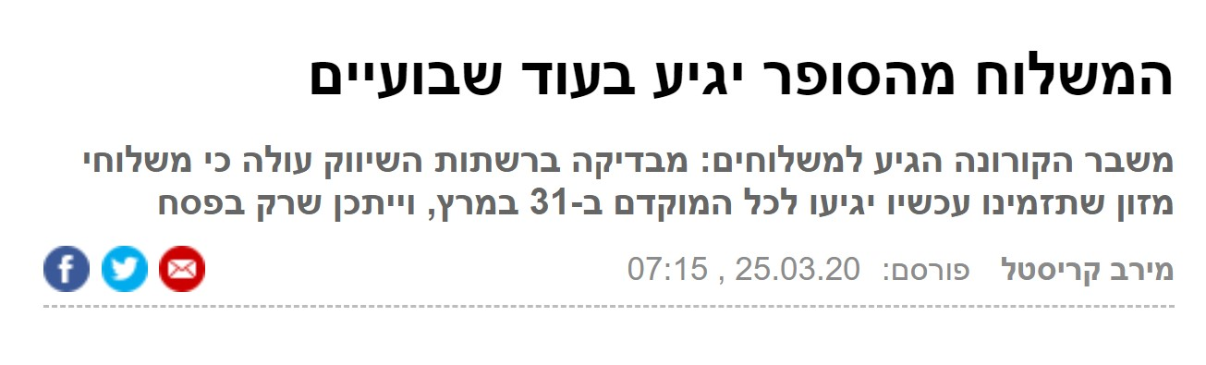
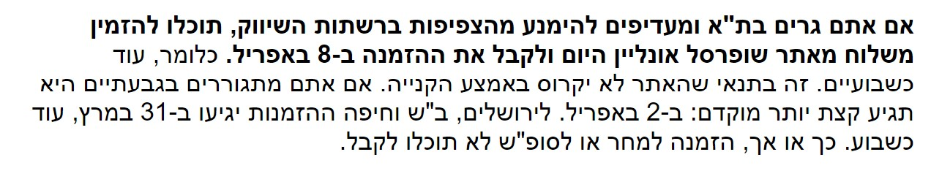
Example from Israel
Israel newspaper:
“Delivery from the supermarket will arrive in two weeks The Corona crisis has come to shipment: A review of the marketing networks shows that food deliveries you order now arrive at the earliest on March 31, and it may only be during Passover”.
“If you live in Tel Aviv and prefer to avoid overcrowding in the marketing networks, you can order a delivery from Shufersal Online today and receive your order on April 8. That is, about two weeks. This is provided that the site will not collapse in the middle of the shopping. April 2 To Jerusalem, Beersheba and Haifa the orders will arrive on March 31, about a week later. Either way, you will not receive an order for tomorrow or weekend”.

Slide 7
Our solution
GrowCherry created a network for Grocery stores that allows customers to shop online in the most accessible way for elderly and whom can’t leave their homes. Our Network create job opportunities for individuals, while giving local stores the ability to make deliveries using outsource delivery services.

Slide 8
Locally customized
a global solution
Our main goal
We at GrowCherry see this opportunity to impact a global problem with a unique local customized solution . By creating a local solution we will create on-going global solution to one of the main problems humanity needs to deal with in times of social distancing, quarantine and movement restrictions.

Slide 9
GrowCherry Stakeholders & Target Market
GrowCherry
Customers,
online buyers
Local Grocery stores
Delivery people and couriers

Slide 10
One Network for all
local grocery stores
Growcherry created a website platforms which feets any store as a new way to shop for online delivery, without dependency on a specific physical shop.
our vision is to create an easy implementation process to every new shop, by using the shops inventory, as a one time on-boarding app, to future use in any delivery.

Slide 11
App for Couriers
We created an App ment for the Couriers to help them find the deliveries and follow their income.
We create job opportunities by letting any Independent workers with a driver license to choose to work as our couriers all they need is a driving license, self-employed documentation, and we will provide them the Emergency work permit
our Courier gets paid for every delivery they do, and not based by the hour.

Slide 12
A user friendly
Shopping platform for buyers
Creating a new perspective on food information architecture in mind we created easy to understand categories and easy to use platform
our customers can enjoy using a friendly well design website, with any need of accessibility help, without having to go through hundreds of products.
While in other online shopping platforms the customers see hundreds of products irrelevant to them. We created filters for the customers diet needs, allergies and food preferences. So it hides all the irrelevant products.

Slide 13
Our Revenue & Business model
At this current times, fast implementation is needed to help reduce the traffic in other online stores. Accordingly we will on-board our first Local stores free of charge. and the First 20 stores will not have to pay service fees for 4 months
this will allow us to collect user-feedback, and upgrade our performances.
As of future business strategy,our first customers will be based in Israel, and charging funds and fees will be according to this way:
online buyers will pay for delivery service fee 30 shekels, where 3% of the charge will go to our future company and the 97% to the curier.
every new shop will have to pay a fixed price of 350 shekels for the first on-boarding
and every month we will charge 3% of the revenue from ordering using our system. This only if they reached at least 88 orders. If there are between 87 and 72 we will charge 3.4%. From 71 orders and under we will charge 4% fee. nevertheless, not less than 600 shekels a month

Slide 14






competitive landscape - Shipping option areas
Available in UK
Available in USA
Available in Israel
Available Globally
GrowCherry can be implemented globally

Slide 15



Competitive landscape
Company | Deliver groceries | Fast Delivery in COVID-19 period | User Friendly
 | V | V | V
 | V | X | X
 | V | X | V
 | V | X | V
 | X | V | V
 | X | V | V

Slide 16
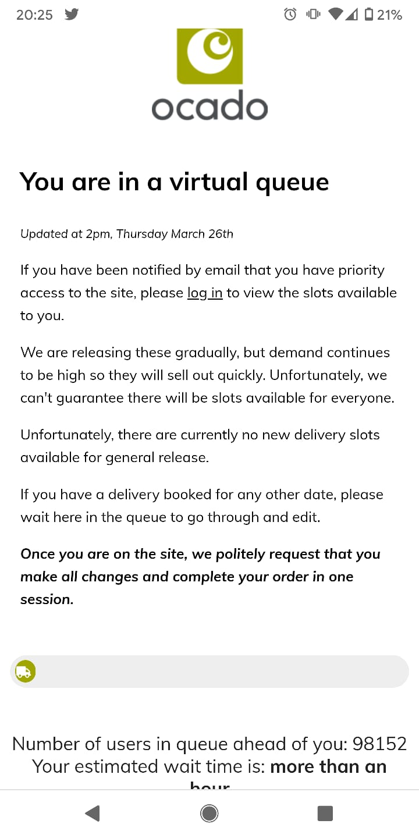
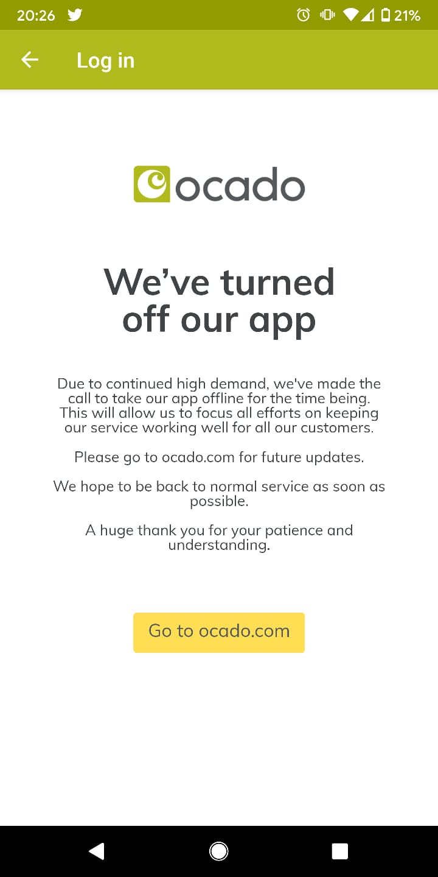
Ocado - as an example
While we were looking for competing companies that do food delivery. We found Ocado, a British online supermarket that makes food deliveries independent of physical stores.
Independent Newspaper:
“Supermarket websites and online grocers such as Ocado
have also been hit by the surge in orders, with some
supermarkets forced to ration certain items to ensure they
are available to all customers”.
BBC Newspaper:
“This has been a sticking point for many people, who are
finding themselves unable to book slots and follow Prime
Minister Boris Johnson's request to use online
deliveries and stay at home.Ocado, which also delivers
Waitrose food, has had very lengthy waits on its website”.

Slide 17
Vision and Goals to the future
Enlarge the interest to more types of stores - any kind of store would be able to make a delivery
implement our product globally - considering cultural differences
Open the possibility to create employee agreement for couriers that can’t be self-employed in order to help handle deliveries times and process
Create back-office platform to manage our paying customers, dealing with their deliveries and updating their inventory as much as possible
Creating legal engagement with countries and governments to help more people to get work permits as couriers.
Create connections with Donation associations to help get free delivery to more elderly, disabled people or anyone who can't leave their homes.
Invest in further research for understanding needs of disabled people.

Slide 18
Future Products
Creating subsidiary product with the main interest of creating a build-in application for deliveries that can be used by any website owners.
Such as outsourcing deliveries built on a plugin to implement at any websites.

Slide 19
Want to see our process?
click links for further information
Link to the demo
Product & Business information
GrowCherry - Shared Documents (Google Drive) designing process and mockups
GrowCheey - UX, UI and Flow Design (Figma)
GitHub code for backend & frontend App
Growcherry - Complete App Development (GitHub)
GitHub code for backend
GrowCherry - Web Research phase Backend Development (GitHub)

Slide 20
Thank you!

Slide 21

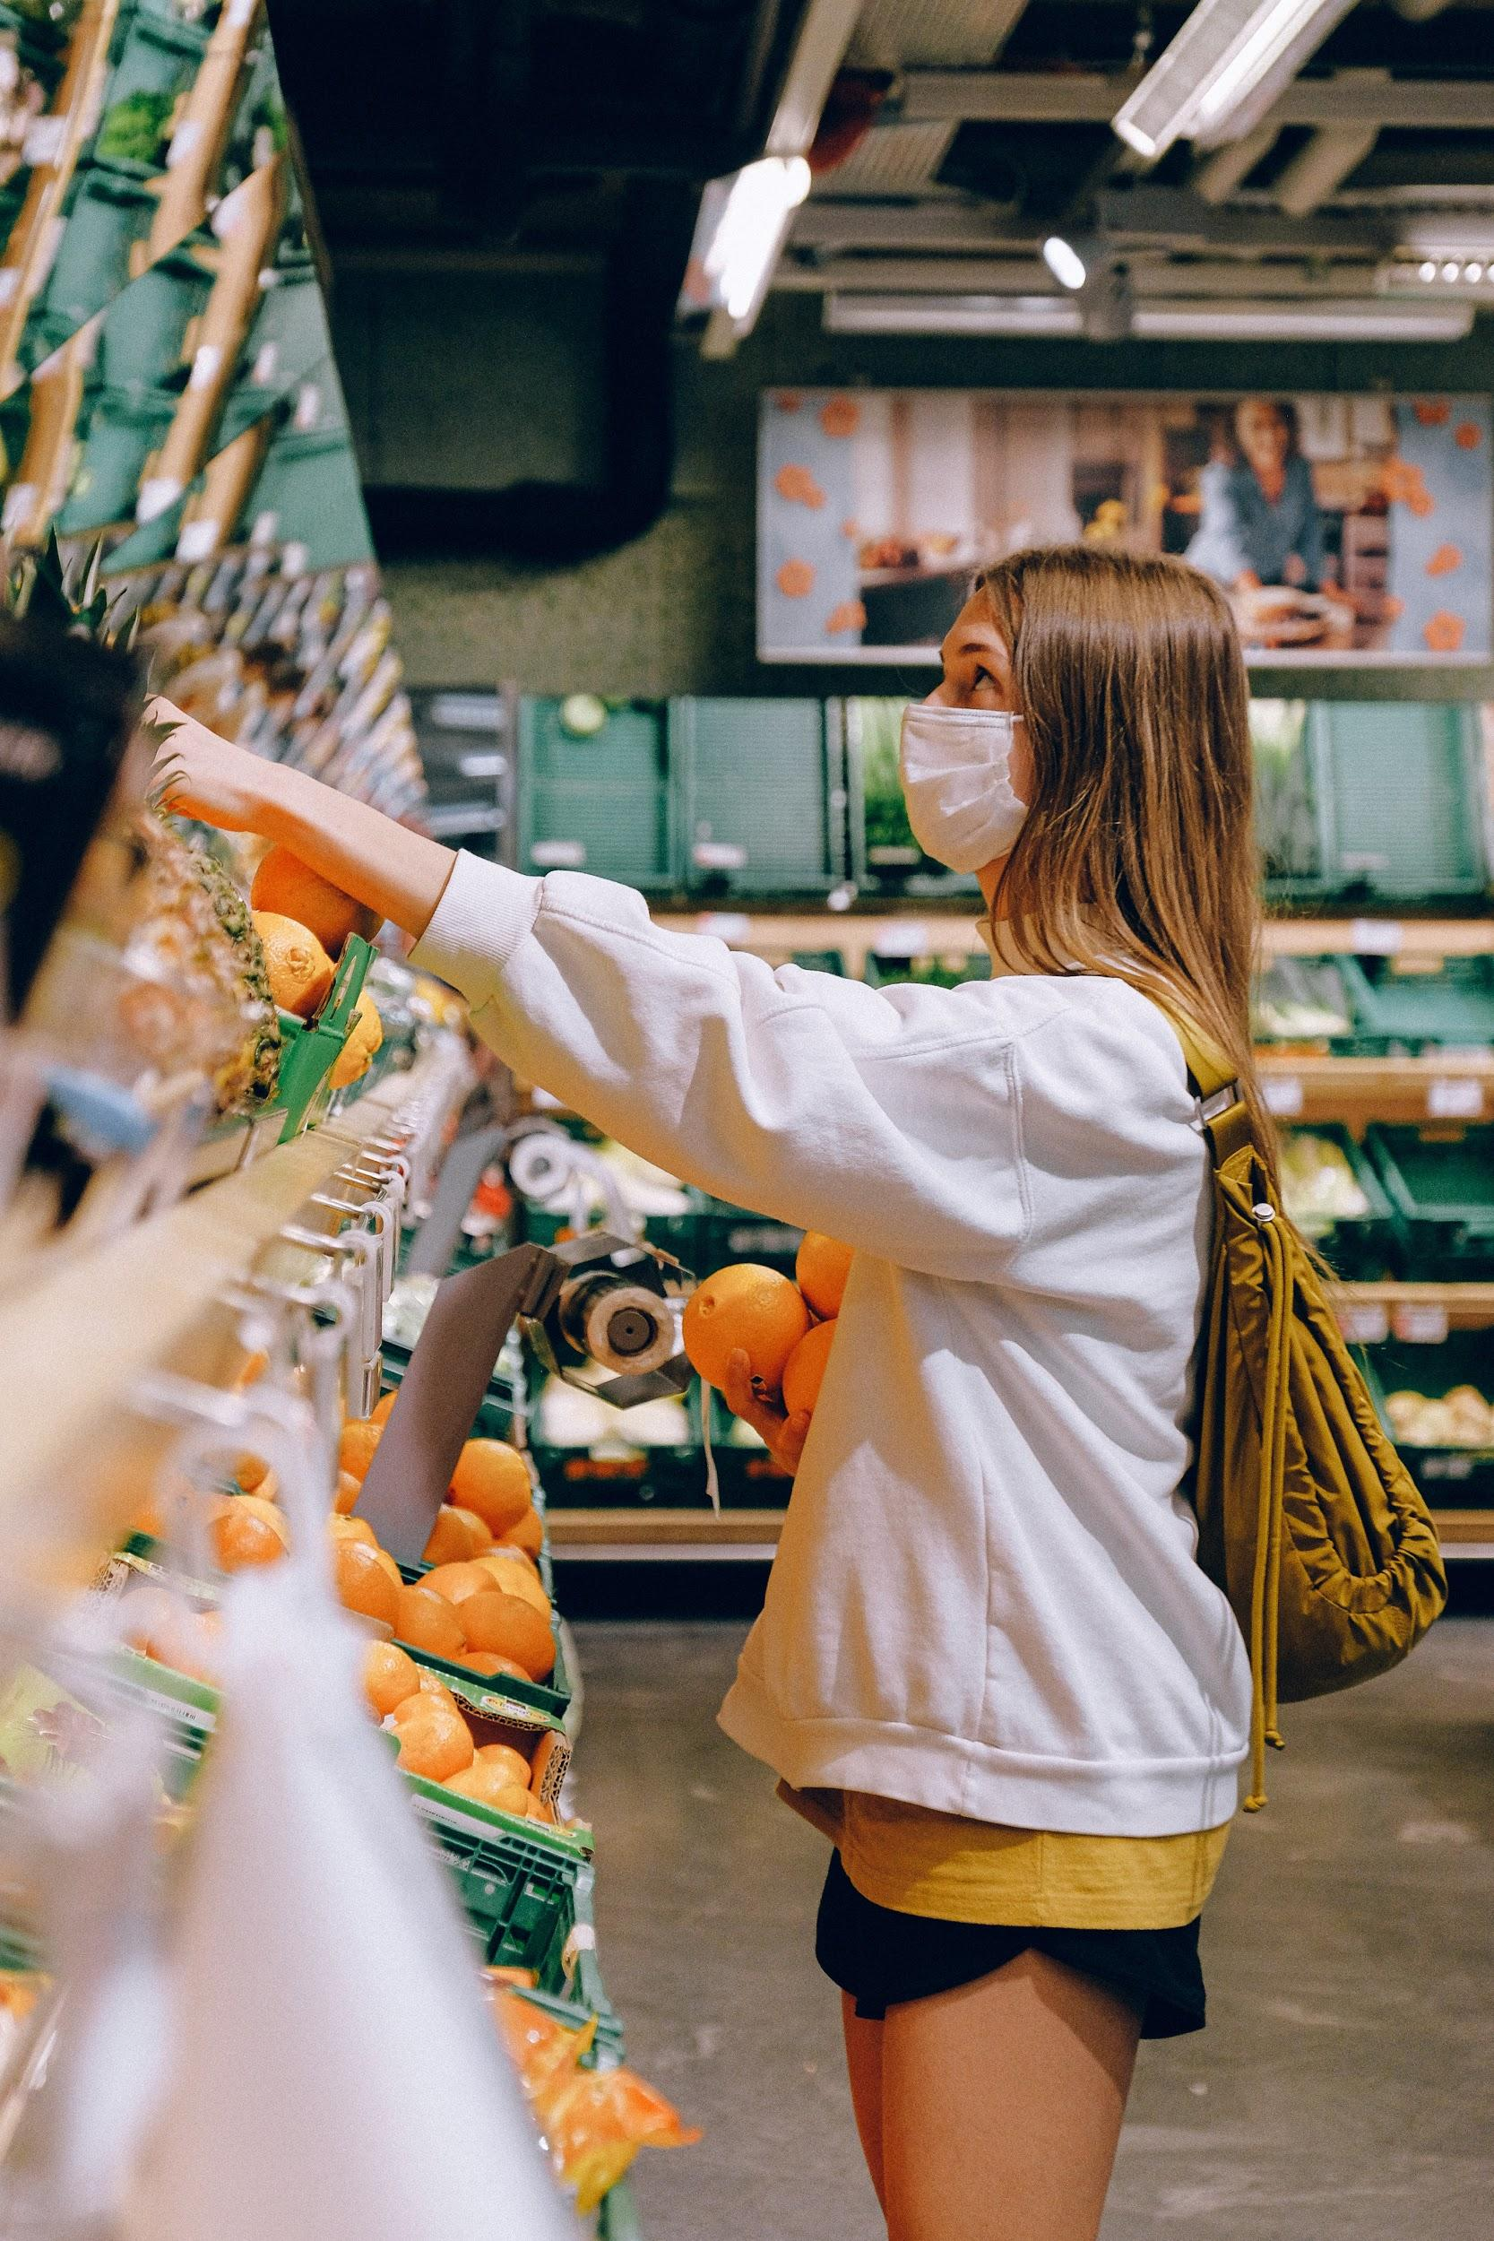


Adva, if you need use it - if not the demo will show this -> The Main Flow
The Customer
The Grocery Shop
The Delivery person
The Delivery

